Slide 1
Learning visual language models for video understanding
Antoine Yang
https://antoyang.github.io/

Slide 2
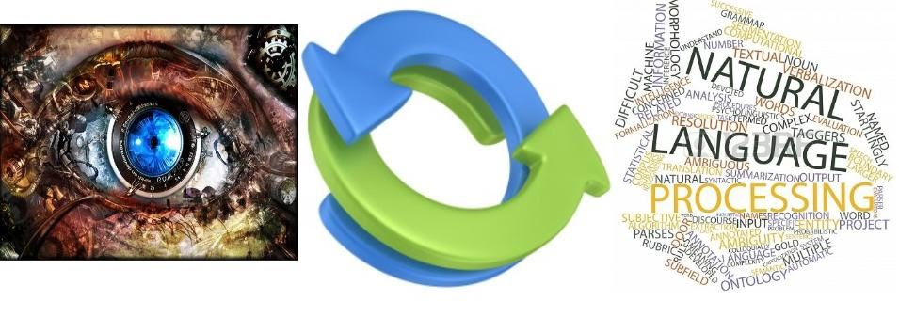
Visual language models
Language is a fundamental aspect of human communication
Vision is a fundamental aspect of human perception
-> Developing machines that can process both is crucial e.g. for human-computer interaction, search, customer support, accessibility…
Notes:
humans // machines// multi-modal search sketch + text -> image; customer support when assembling a furniture; accessibility by describing visual content for visually impaired people

Slide 3

Example of a visually-aware chatbot
Notes:
openai prez

Slide 4
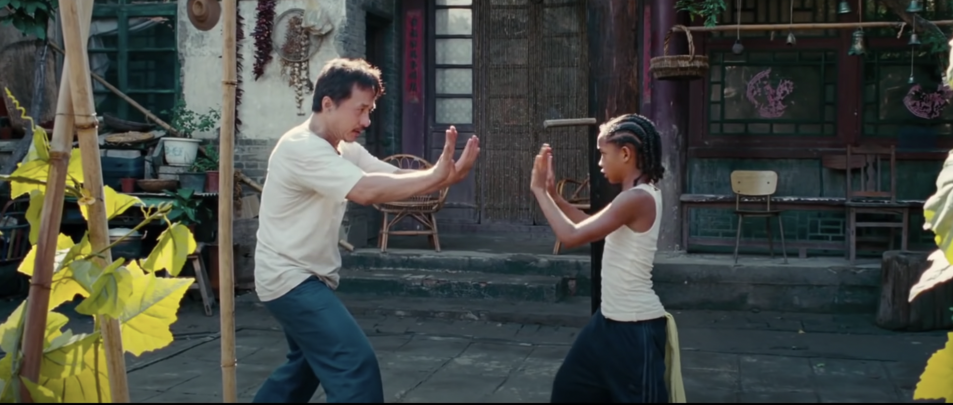
What are they doing? -> Martial arts
Notes:
What is a good visual language model? -> should answer visual questions

Slide 5
How many men are there? -> 2
Notes:
Should have the flexibility to answer other types of questions and not be an action classifier

Slide 6

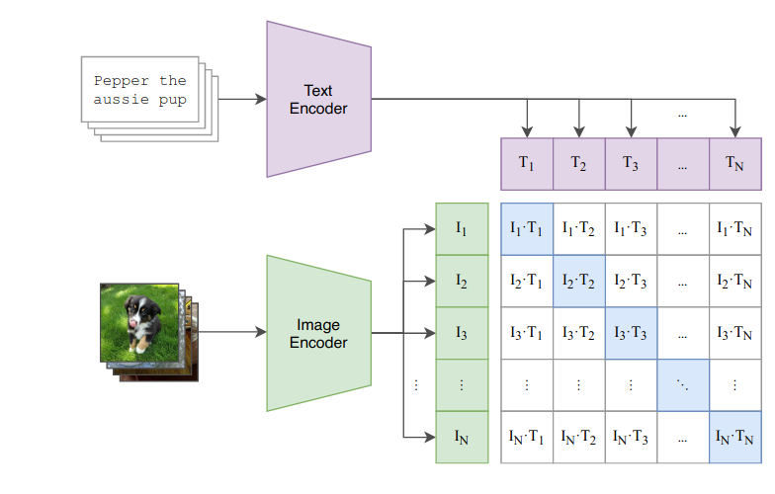
What does a machine need to do that?
Question-answering ability
Vision-language understanding
Notes:
We are gonna build on models that have QA ability / image-text matching ability. How to connect these two?

Slide 7
Why does the kid trust the man?
Notes:
Are these skills enough to answer this question?

Slide 8
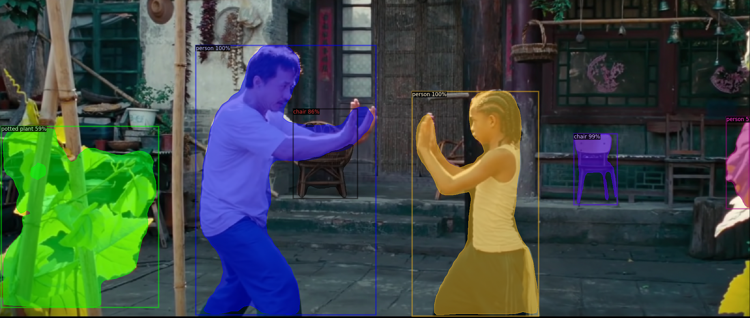
Scene understanding is not enough!
Caption: two people in a garden doing martial arts.
Notes:
MASK RCNN / BLIP

Slide 9
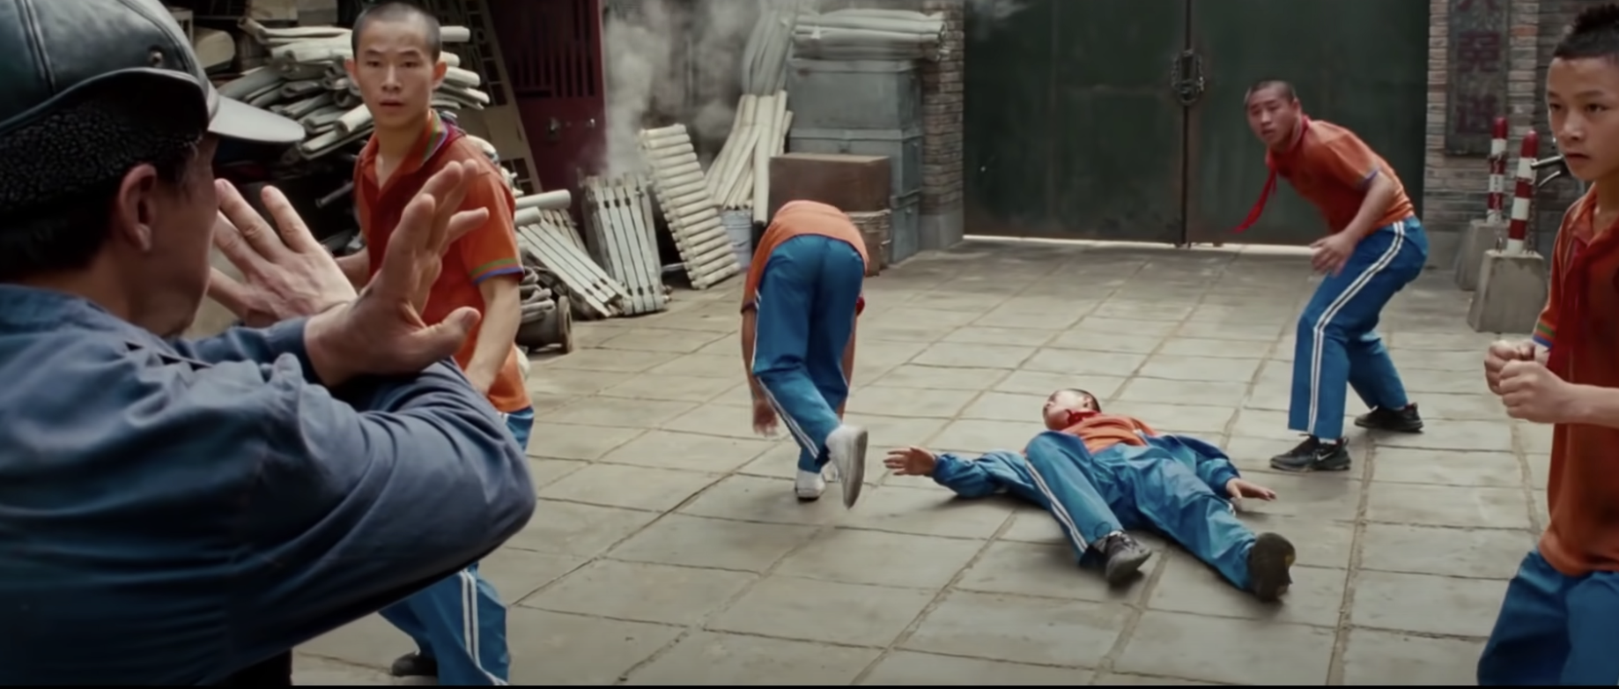
Because the man saved his life!
Notes:
But if you have watched the previous scenes in the movie…

Slide 10
What else do we need?
…
Localizing events in time
Multi-event reasoning
…
…

Slide 11
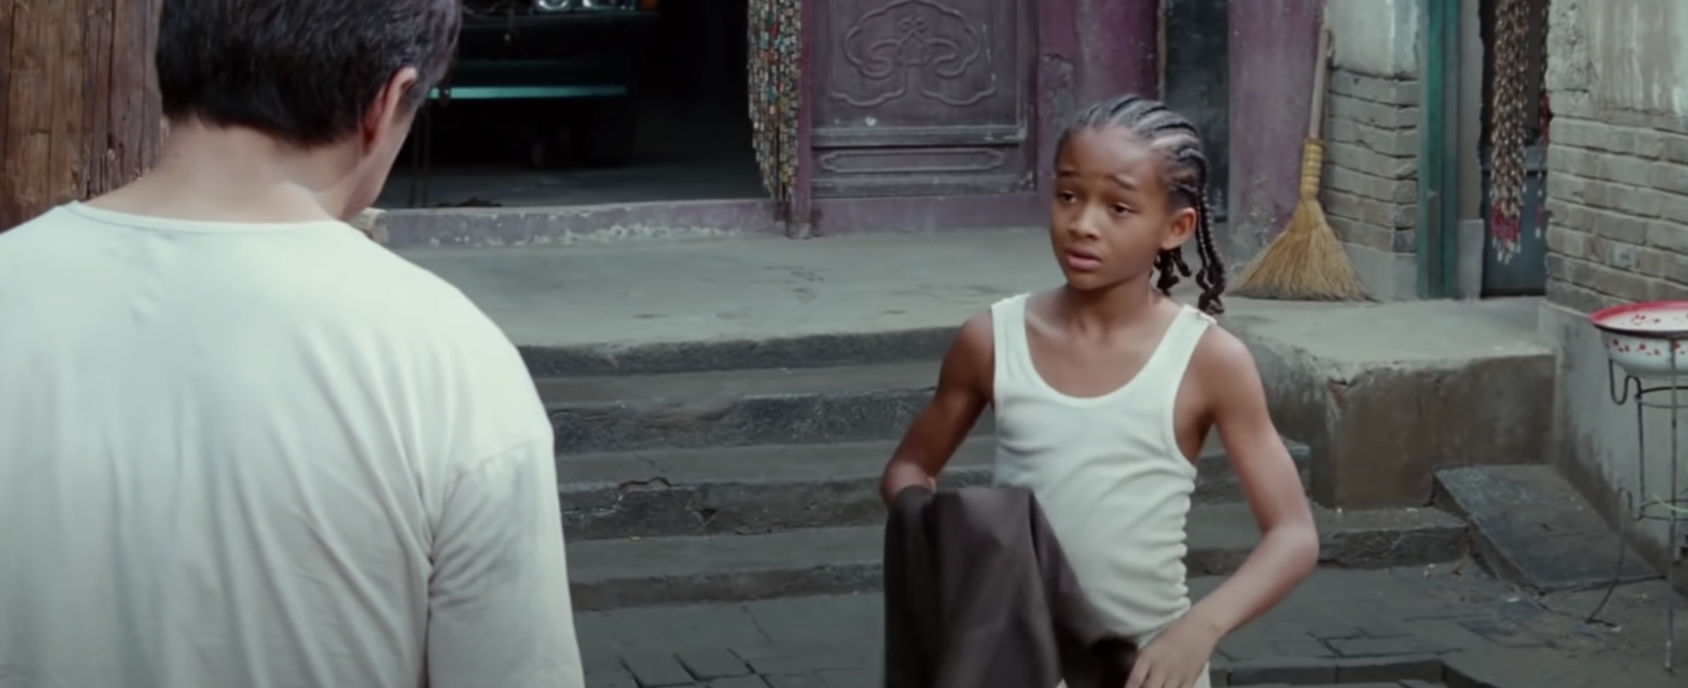
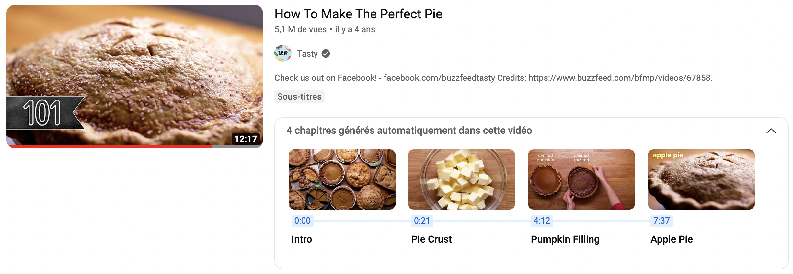
Applications: Beyond answering questions
Video-to-text summarization
Improved navigation with automatically generated video chapters
This video is about a kid that learns kung fu. First the kid is attacked by 6 aggressors. A man appears and defeat them, thereby saving the kid’s life. The kid then starts training with the man and becomes stronger day after day. He ends up winning a prestigious competition against his toughest aggressors.

Slide 12

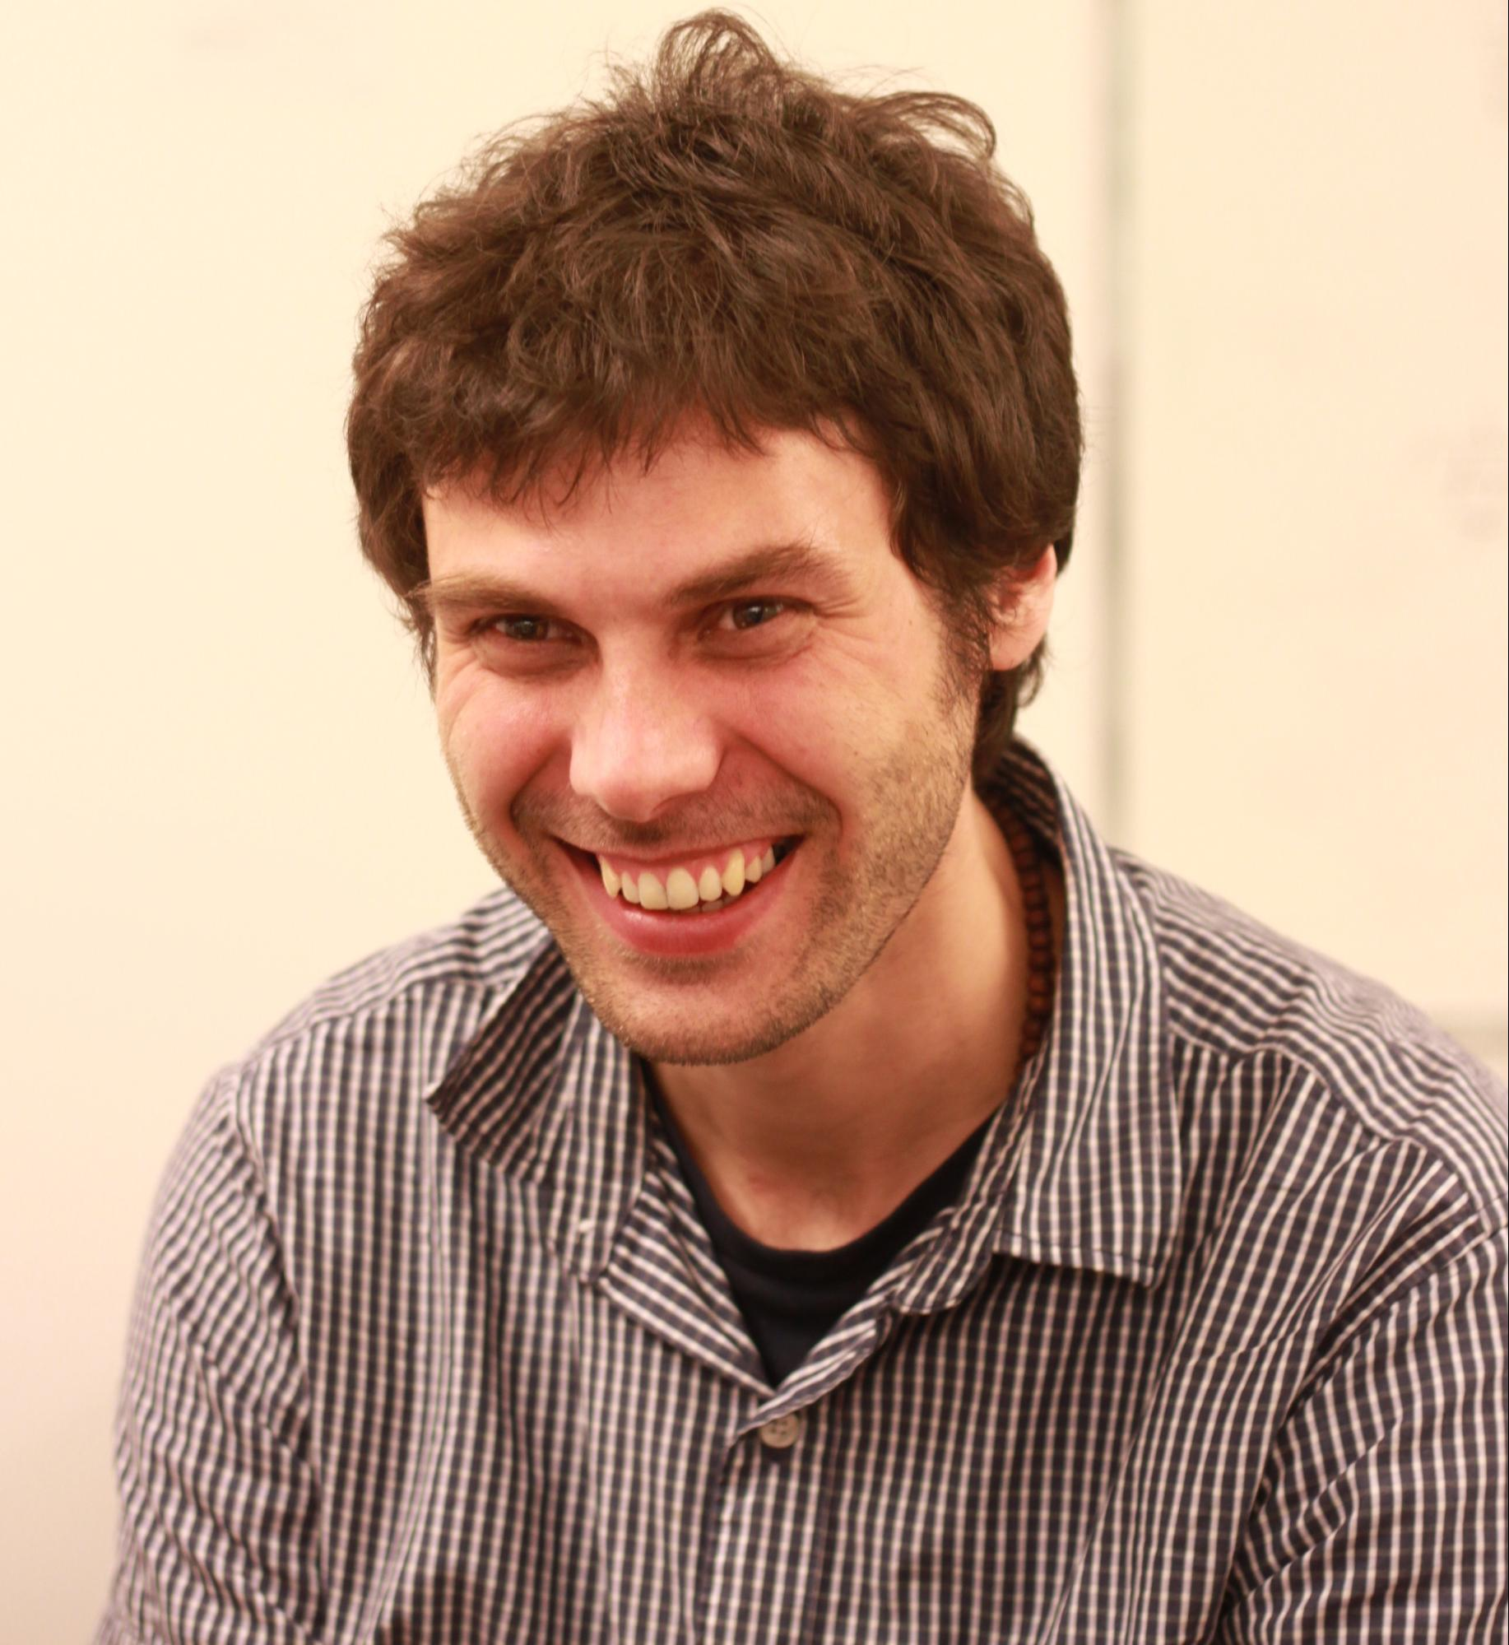
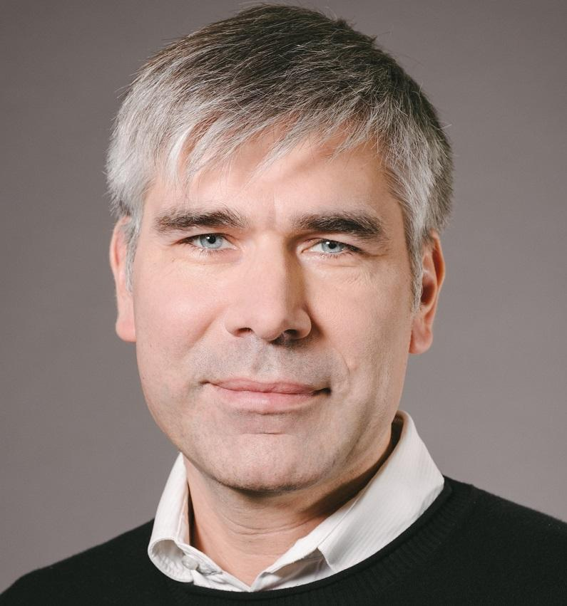
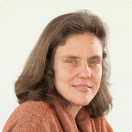
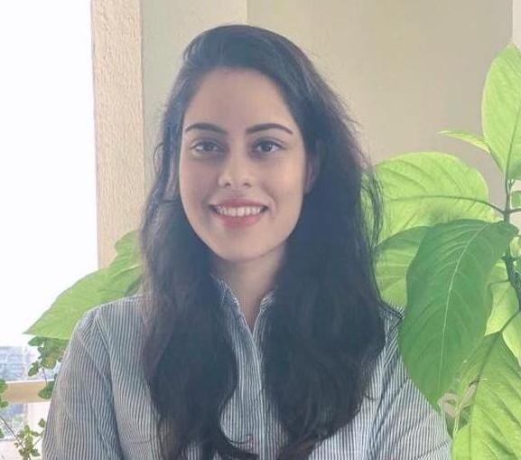
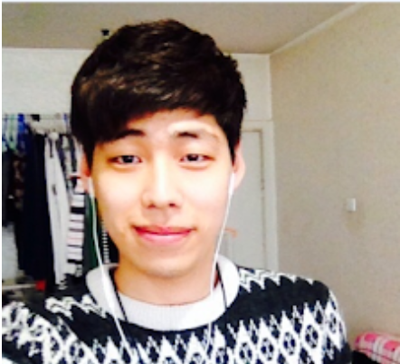
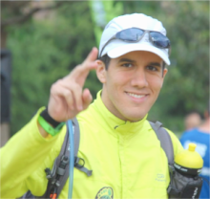
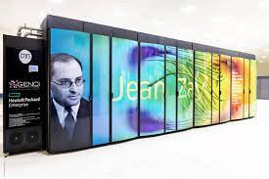

Collaborators
Antoine Miech (DeepMind)
Josef Sivic
(CIIRC CTU Prague)
Ivan Laptev
(Inria)
Cordelia Schmid
(Inria / Google)
Jean Zay (IDRIS)
Arsha Nagrani (Google)
Paul Hongsuck Seo (Google)
Jordi Pont-Tuset (Google)

Slide 13
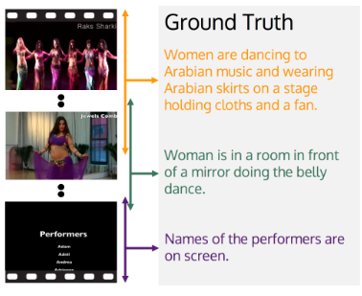
Dense Video Captioning
Task: generate temporally localized captions for all events in an untrimmed minutes-long video.
Prior approaches (e.g. [Wang 2021]): are task specific and trained only on manually annotated datasets.
Example from the ActivityNet-Captions dataset [Krishna 2017].
[Krishna 2017] Dense-Captioning Events in Videos, Ranjay Krishna et al, ICCV 2017.
[Wang 2021] End-to-End Dense Video Captioning with Parallel Decoding, Teng Wang et al, ICCV 2021.

Slide 14
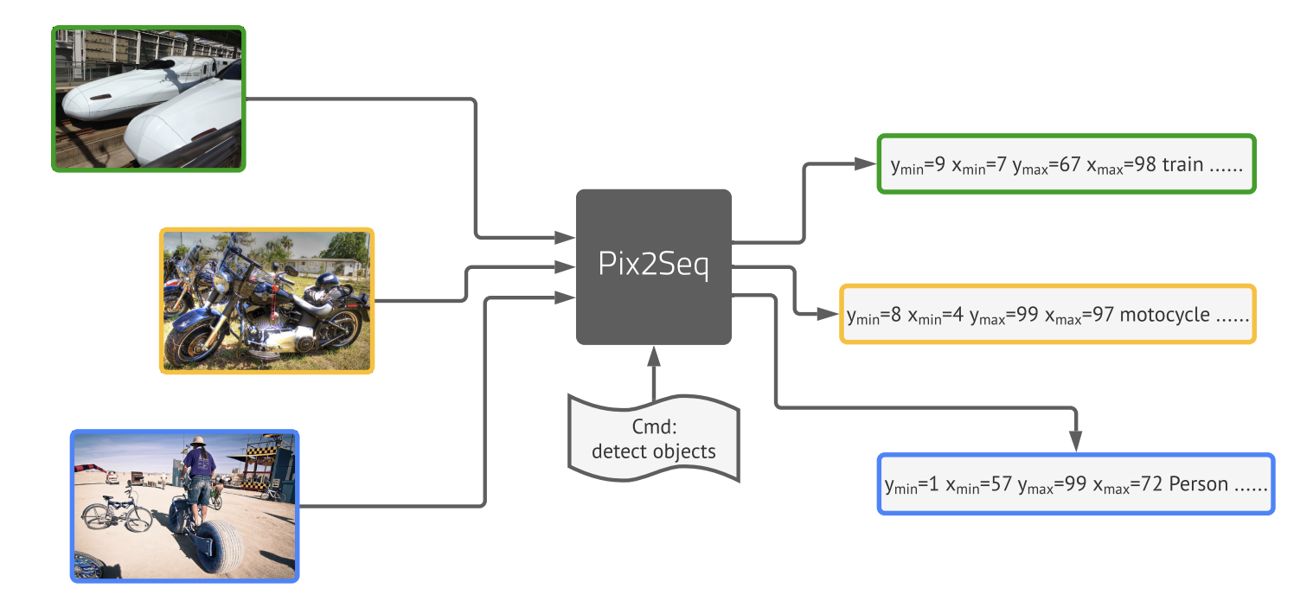
Localization as language modeling
Pix2seq [Chen 2022] casts object detection as sequence generation.
Spatial coordinates are quantized and tokenized.
[Chen 2022] Pix2seq: A Language Modeling Framework for Object Detection, Ting Chen et al, ICLR 2022.

Slide 15
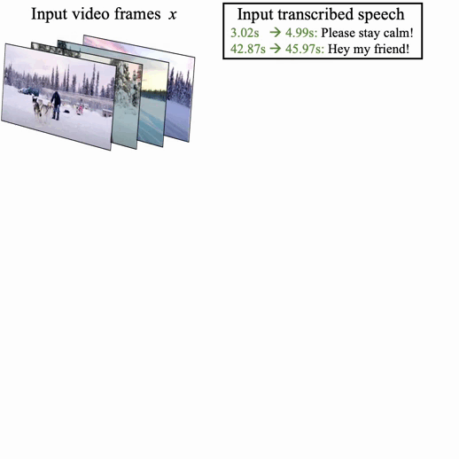
The Vid2Seq model
Formulates dense video captioning as a sequence-to-sequence problem.
Time is quantized and jointly tokenized with the text.
Model architecture: visual encoder, text encoder and text decoder.

Slide 16
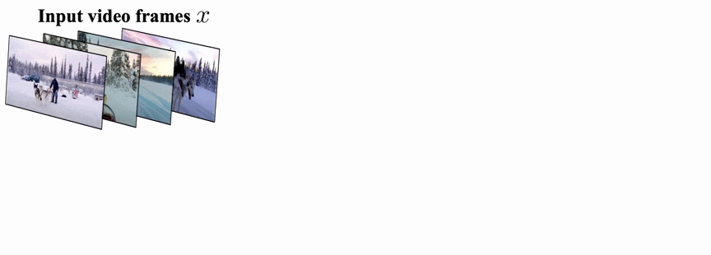
Pretraining Vid2Seq on untrimmed narrated videos
Speech is also cast as a single sequence of text and time tokens.
Generative objective: given visual inputs, predict speech.
Denoising objective: given visual inputs and noisy speech, predict masked speech tokens.

Slide 17
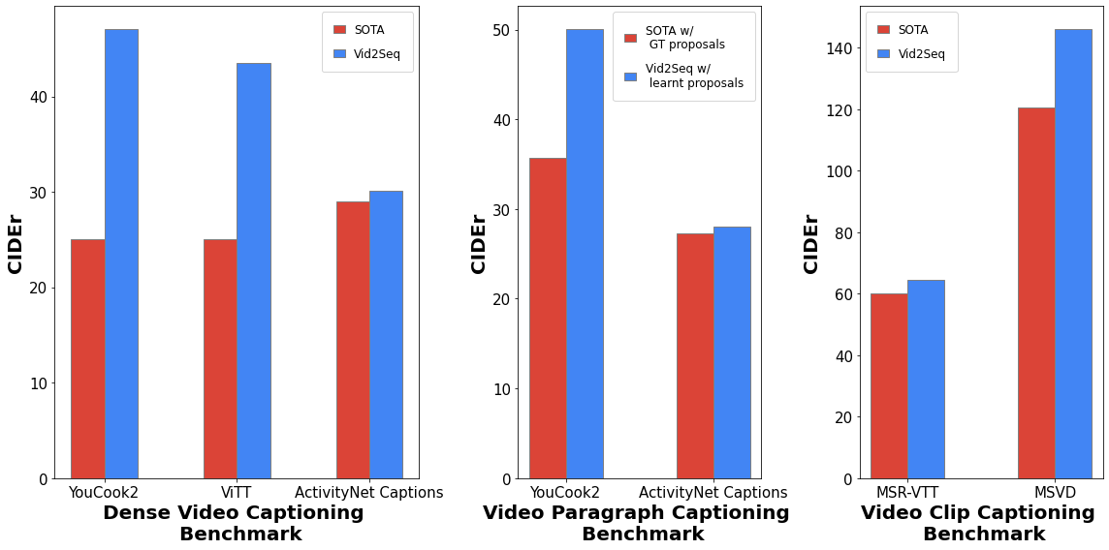
Vid2Seq is SoTA on video captioning tasks.
[Wang 2021] End-to-End Dense Video Captioning with Parallel Decoding, Teng Wang et al, ICCV 2021.
[Zhu 2022] End-to-end Dense Video Captioning as Sequence Generation, Wanrong Zhu et al, COLING 2022.
[Lei 2020] MART: Memory-Augmented Recurrent Transformer for Coherent Video Paragraph Captioning, Jie Lei et al, ACL 2020.
[Seo 2022] End-to-end Generative Pretraining for Multimodal Video Captioning, Paul Hongsuck Seo et al, CVPR 2022.
[Lin 2022] SwinBERT: End-to-End Transformers with Sparse Attention for Video Captioning, Kevin Lin et al, CVPR 2022.

Slide 18
Vid2Seq has competitive event localization performance without task-specific design.
Model | YouCook2 |  | ViTT |  | ActivityNet Captions
 | Recall | Precision | Recall | Precision | Recall | Precision
SoTA | 20.7 | 20.6 | 32.2 | 32.1 | 59.0 | 60.3
Vid2Seq | 27.9 | 27.8 | 42.6 | 46.2 | 52.7 | 53.9
[Wang 2021] End-to-End Dense Video Captioning with Parallel Decoding, Teng Wang et al, ICCV 2021.
[Zhu 2022] End-to-end Dense Video Captioning as Sequence Generation, Wanrong Zhu et al, COLING 2022.

Slide 19
Vid2Seq generalizes well to few-shot settings.
We also find that pretraining is crucial for few-shot generalization.
Data | YouCook2 |  |  | ViTT |  |  | ActivityNet Captions
 | SODA | CIDEr | METEOR | SODA | CIDEr | METEOR | SODA | CIDEr | METEOR
1% | 2.4 | 10.1 | 3.3 | 2.0 | 7.4 | 1.9 | 2.2 | 6.2 | 3.2
10% | 3.8 | 18.4 | 5.2 | 10.7 | 28.6 | 6.0 | 4.3 | 20.0 | 6.1
50% | 6.2 | 32.1 | 7.6 | 12.5 | 38.8 | 7.8 | 5.4 | 27.5 | 7.8
100% | 7.9 | 47.1 | 9.3 | 13.5 | 43.5 | 8.5 | 5.8 | 30.1 | 8.5

Slide 20
Benefits of pretraining on untrimmed videos
Unlike standard video captioning pretrained models, Vid2Seq is pretrained on untrimmed narrated videos (where speech sentences are split by the time tokens).
Pretraining input |  | YouCook2 |  |  | ActivityNet Captions
Untrimmed | Time tokens | SODA | CIDEr | F1 | SODA | CIDEr | F1
✗ | ✗ | 4.0 | 18.0 | 18.1 | 5.4 | 18.8 | 49.2
✓ | ✗ | 5.5 | 27.8 | 20.5 | 5.5 | 26.5 | 52.1
✓ | ✓ | 7.9 | 47.1 | 27.3 | 5.8 | 30.1 | 52.4

Slide 21
Effect of pretraining losses and modalities
The visual inputs only model benefits from the generative objective.
The denoising objective helps the model with visual+speech inputs.
Finetuning Input |  | Pretraining losses |  | YouCook2 |  |  | ActivityNet Captions
Visual | Speech | Generative | Denoising | SODA | CIDEr | F1 | SODA | CIDEr | F1
✓ | ✗ | No pretraining |  | 3.0 | 15.6 | 15.4 | 5.4 | 14.2 | 46.5
✓ | ✓ | No pretraining |  | 4.0 | 18.0 | 18.1 | 5.4 | 18.8 | 49.2
✓ | ✗ | ✓ | ✗ | 5.7 | 25.3 | 23.5 | 5.9 | 30.2 | 51.8
✓ | ✓ | ✓ | ✗ | 2.5 | 10.3 | 15.9 | 4.8 | 17.0 | 48.8
✓ | ✓ | ✓ | ✓ | 7.9 | 47.1 | 27.3 | 5.8 | 30.1 | 52.4

Slide 22
Captioning helps localization after pretraining.
Contextualizing the noisy speech boundaries with their semantic content is important.
Captioning | Pretraining | YouCook2 |  |  | ActivityNet Captions
 |  | Recall | Precis | F1 | Recall | Precis. | F1
✗ | ✗ | 17.8 | 19.4 | 17.7 | 47.3 | 57.9 | 52.0
✓ | ✗ | 17.2 | 20.6 | 18.1 | 42.5 | 64.1 | 49.2
✗ | ✓ | 25.7 | 21.4 | 22.8 | 52.5 | 53.0 | 51.1
✓ | ✓ | 27.9 | 27.8 | 27.3 | 52.7 | 53.9 | 52.4

Slide 23
Data and model scaling.
Language Model | Pretraining |  | YouCook2 |  |  | ActivityNet Captions
 | # Videos | Dataset | SODA | CIDEr | F1 | SODA | CIDEr | F1
T5-Small | 15M | YTT | 6.1 | 31.1 | 24.3 | 5.5 | 26.5 | 52.2
T5-Base | 0 | - | 4.0 | 18.0 | 18.1 | 5.4 | 18.8 | 49.2
T5-Base | 15K | YTT | 6.3 | 35.0 | 24.4 | 5.1 | 24.4 | 49.9
T5-Base | 150K | YTT | 7.3 | 40.1 | 26.7 | 5.4 | 27.2 | 51.3
T5-Base | 1M5 | YTT | 7.8 | 45.5 | 26.8 | 5.6 | 28.7 | 52.2
T5-Base | 1M | HTM | 8.3 | 48.3 | 26.6 | 5.8 | 28.8 | 53.1
T5-Base | 15M | YTT | 7.9 | 47.1 | 27.3 | 5.8 | 30.1 | 52.4

Slide 24
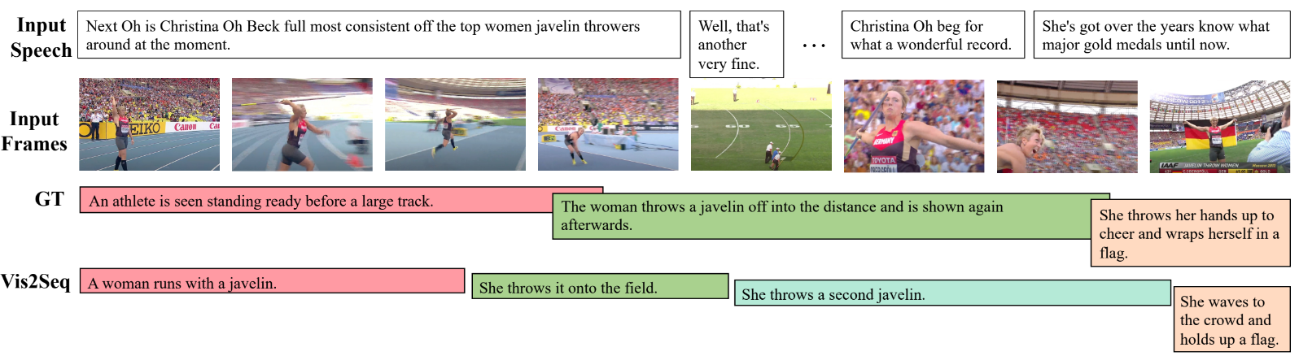
Qualitative results
More examples: https://www.youtube.com/watch?v=3oEHSU5ExsI

Slide 25
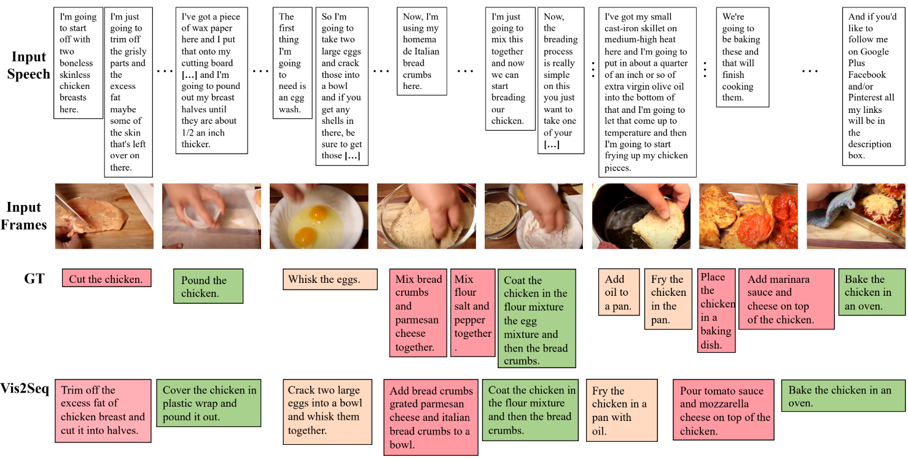
Qualitative results

Slide 26
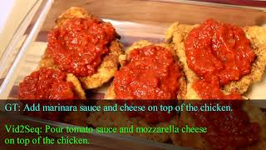
Qualitative results

Slide 27
Conclusion
Vid2Seq is a visual language model for dense video captioning.
Vid2Seq can be effectively pretrained on unlabeled narrated videos at scale.
The pretrained Vid2Seq model improves the SoTA on 3 dense video captioning datasets, 2 video paragraph captioning datasets, 2 video clip captioning datasets, and generalizes well to few-shot setting.

Slide 28
Limitations
Vid2Seq cannot use raw audio inputs (beyond speech transcripts).
Does Vid2Seq generalize to other tasks, e.g. VideoQA or temporal action localization?
Pretraining gains are subject to video domain -> Vid2Seq event localization performance is below task-specific approaches on ActivityNet Captions.

Slide 29
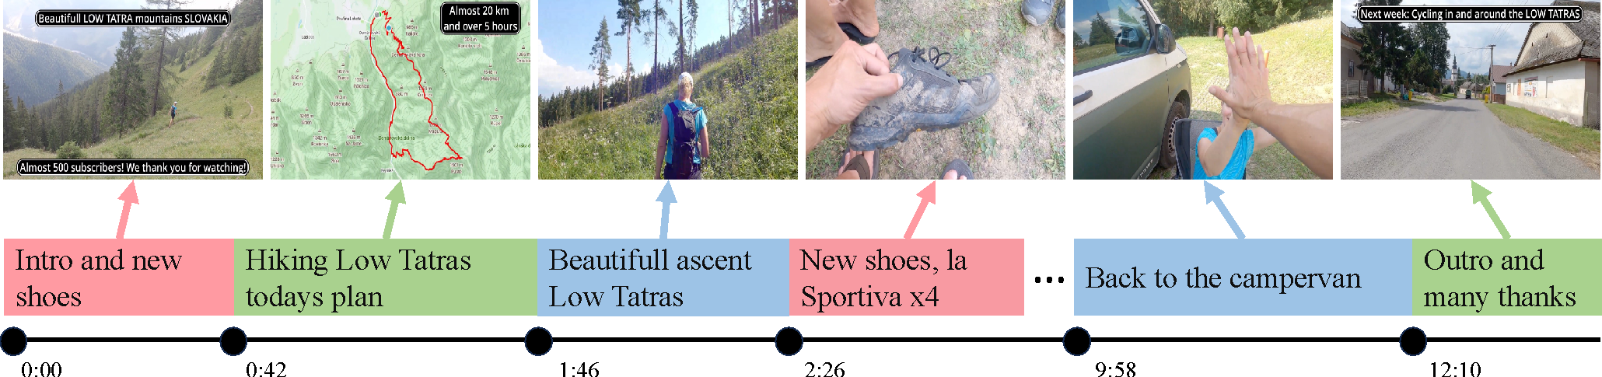
Video Chapter Generation
Goal: improve navigation in long videos.
Task: segment a long video into segments and generate a chapter title for each.

Slide 30
Data collection procedure
Large pool of 92M YouTube videos [1]
Download description + check presence of chapters
Smaller pool of 817K videos with chapter annotations
[1] MERLOT Reserve: Neural Script Knowledge through Vision and Language and Sound, R. Zellers et al, CVPR 2022.

Slide 31
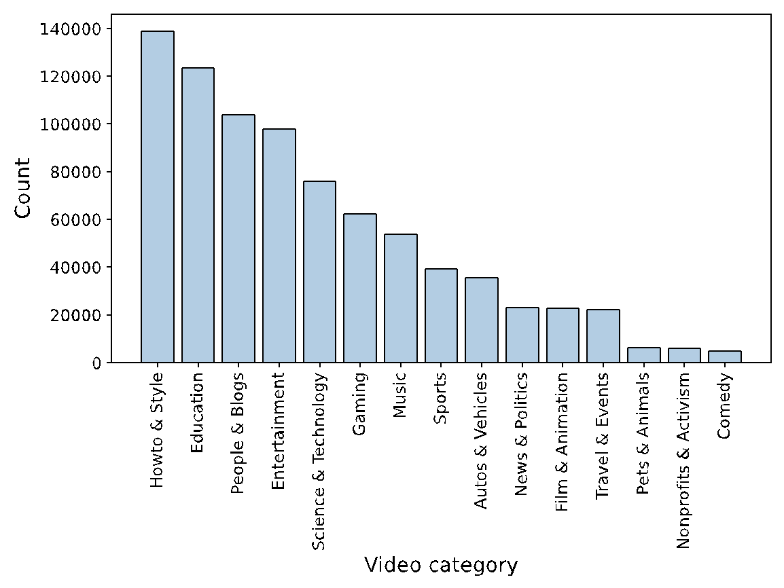
Data statistics
817K videos & 7M chapters
8 chapters per video (avg)
Chapter duration (avg): 142s
Video duration (avg): 1354s
97% videos with ASR
93% videos in English

Slide 32
Comparison with other datasets
Dataset | # Videos | Duration (min) | # Descriptions | Annotations
HowTo100M | 1M | 7 | 136M | ASR
YT-Temporal-1B | 19M | 6 | 900M | ASR
HD-VILA-100M | 3M | 7 | 103M | ASR
ActivityNet Captions | 20K | 3 | 100K | Dense captions
YouCook2 | 2K | 6 | 15K | Dense captions
ViTT | 8K | 4 | 56K | Dense captions
Ego4D | 10K | 23 | 4M | Dense captions
VidChapters-7M | 817K | 23 | 7M | ASR+Chapters

Slide 33
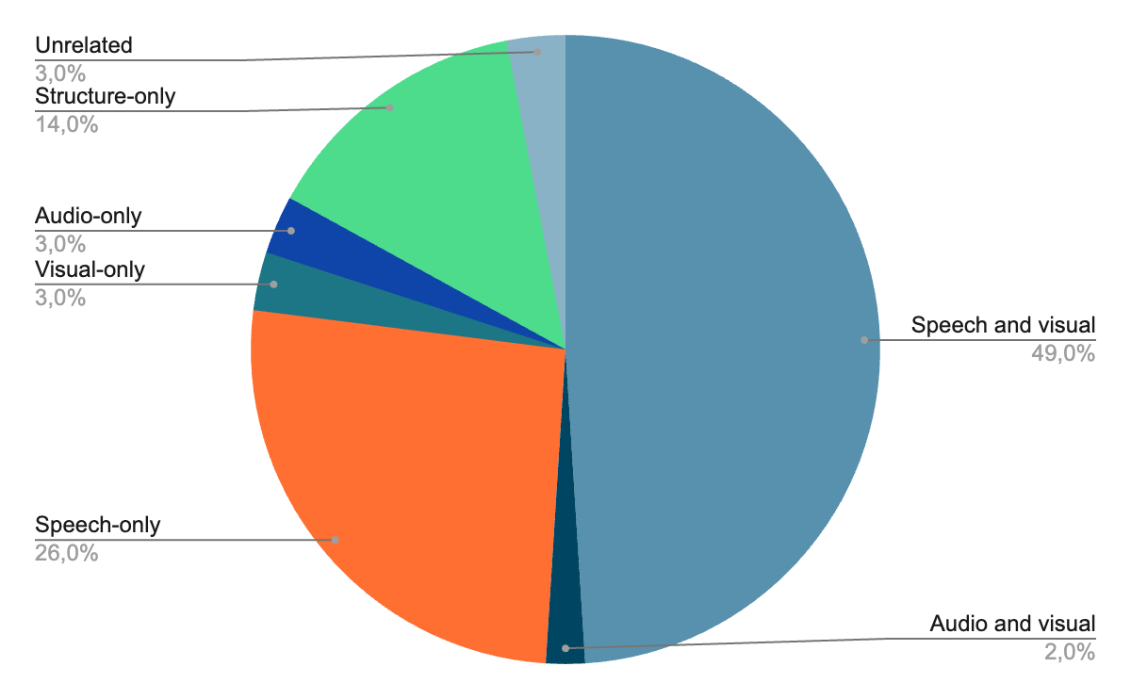
Manual assessment

Slide 34
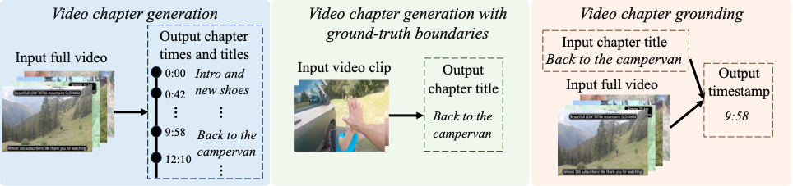
New benchmarks

Slide 35
Video chapter generation
Model | Modalities | PT Data | FT VC | SODA | CIDEr | METEOR | R@3s | P@3s | R@0.7 | P@0.7
Text tiling + LLaMA | T | Text mix | No | 0.2 | 0.5 | 0.3 | 5.8 | 7.9 | 8.9 | 8.8
Shot detect + BLIP-2 | V | 129M img-txt | No | 0.6 | 0.2 | 0.6 | 27.4 | 29.7 | 12.5 | 8.7
PDVC | V | None | Yes | 6.8 | 35.8 | 9.4 | 17.8 | 40.2 | 22.5 | 26.9
Vid2Seq | T | C4+HTM | Yes | 10.5 | 50.7 | 8.7 | 28.9 | 23.3 | 27.2 | 24.8
Vid2Seq | V+T | C4 | Yes | 10.6 | 51.3 | 8.8 | 28.6 | 23.8 | 26.9 | 24.9
Vid2Seq | V+T | C4+HTM | Yes | 11.4 | 55.7 | 9.5 | 28.5 | 24.0 | 28.5 | 26.4

Slide 36
Video chapter generation given ground-truth boundaries
Model | Modalities | PT Data | FT VC | CIDEr | METEOR
LLaMA | T | Text mix | No | 0.0 | 0.1
BLIP-2 | V | 129M img-txt | No | 12.4 | 2.2
Vid2Seq | V | C4+HTM | Yes | 47.1 | 5.1
Vid2Seq | T | C4+HTM | Yes | 105.3 | 11.5
Vid2Seq | V+T | C4 | Yes | 110.8 | 11.5
Vid2Seq | V+T | C4+HTM | Yes | 120.5 | 12.6

Slide 37
Video chapter grounding
Model | Modalities | PT Data | FT VC | R@3s | R@0.7
BERT | T | Text mix | No | 5.2 | 0.1
CLIP | V | 400M img-txt | No | 3.7 | 2.3
Moment-DETR | V | None | Yes | 12.4 | 17.6

Slide 38
Transfer to dense video captioning
Model | Modalities | PT Data | YouCook2 |  |  | ViTT
 |  |  | SODA | CIDEr | METEOR | SODA | CIDEr | METEOR
SoTA | T+V | C4+YTT | 7.9 | 47.1 | 9.3 | 13.5 | 43.5 | 8.5
PDVC | V | None | 4.8 | 28.8 | 5.8 | 9.4 | 40.6 | 16.5
PDVC | V | VidChap | 5.9 | 34.7 | 7.5 | 10.1 | 41.5 | 16.1
Vid2Seq | T+V | C4+HTM | 8.6 | 53.2 | 10.5 | 14.1 | 44.8 | 8.7
Vid2Seq | T+V | C4+HTM+ 10% VidChap | 9.9 | 63.9 | 12.1 | 14.5 | 47.4 | 9.2
Vid2Seq | T+V | C4+HTM+ VidChap | 10.3 | 67.2 | 12.3 | 15.0 | 50.0 | 9.5

Slide 39
Zero-shot dense video captioning
Model | Modalities | PT Data | YouCook2 |  |  | ViTT
 |  |  | SODA | CIDEr | METEOR | SODA | CIDEr | METEOR
Text tiling + LLaMA | T | None | 0.2 | 0.6 | 0.2 | 0.2 | 0.6 | 0.5
Shot Detect + BLIP-2 | V | VidChap | 0.6 | 1.0 | 0.5 | 0.2 | 0.1 | 0.2
Vid2Seq | T+V | C4+HTM | 0.0 | 0.1 | 0.0 | 0.0 | 0.0 | 0.0
Vid2Seq | T+V | C4+HTM+ 10% VidChap | 3.2 | 11.5 | 3.0 | 6.4 | 21.6 | 5.3
Vid2Seq | T+V | C4+HTM+ VidChap | 3.9 | 13.3 | 3.4 | 9.0 | 28.0 | 6.5

Slide 40
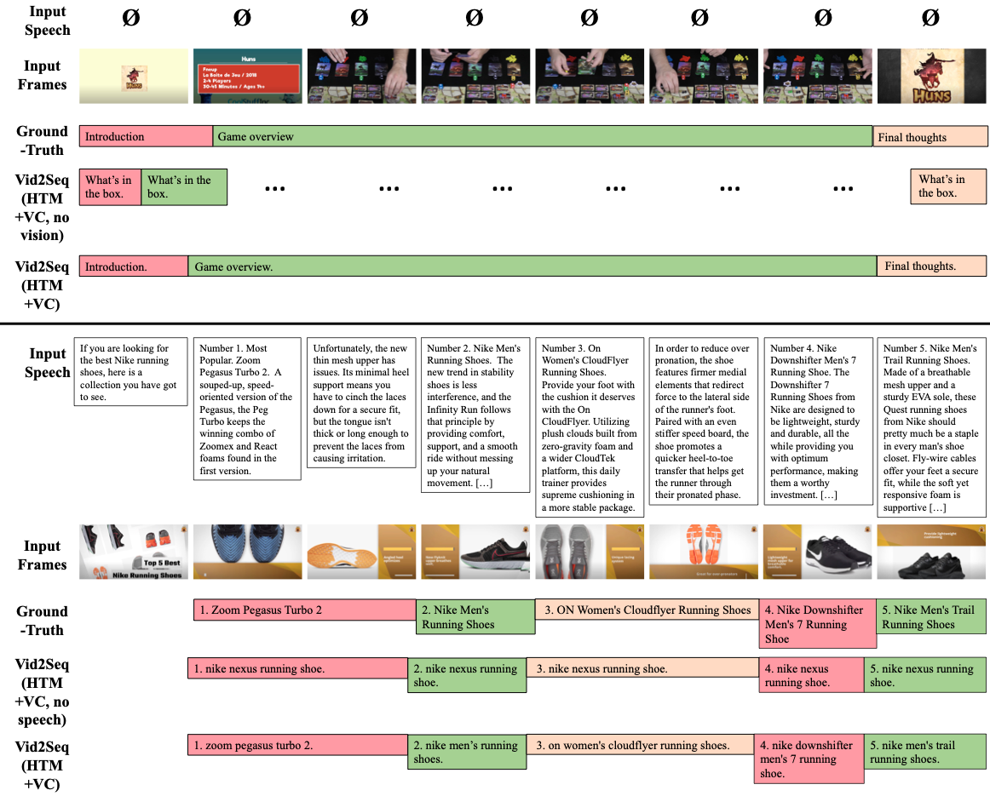
Qualitative examples of video chapter generation

Slide 41
Qualitative examples of video chapter generation

Slide 42
Conclusion
We present VidChapters-7M, a large-scale dataset of user-annotated chapters.
We benchmark baselines and SoTA video-language models on three tasks built on top of VidChapters-7M, including video chapter generation.
Pretraining for video chapter generation transfers well to dense video captioning in both zero-shot and finetuning settings, achieving new SoTA on YouCook2 and ViTT.

Slide 43
Limitations
The distribution of VidChapters-7M is inherited from YT-Temporal-1B, which limits its diversity.
The models evaluated in this work are not specific to chaptering tasks.
Could this dataset be used to pretrain video-language models for other tasks than dense video captioning?

Slide 44
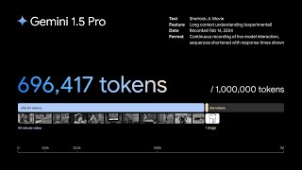
Gemini 1.5: A Visual Language Model that can understand long videos

Slide 45
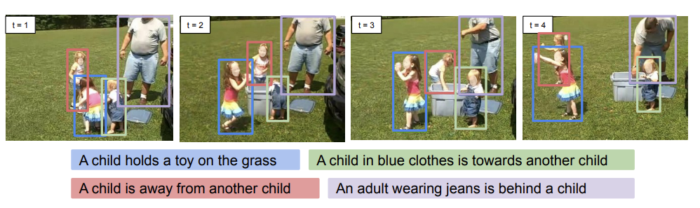
Future work - localized dialog
Build flexible visual language models that can dialog about untrimmed videos and also ground their generated text in space and time.
[Zhou 2023]
[Koh 2023] Grounding Language Models to Images for Multimodal Inputs and Outputs, Jing Yu Koh et al, ICML 2023.
[Zhou 2023] Dense Video Object Captioning from Disjoint Supervision, Xingyi Zhou et al, arXiv 2023.
Notes:
Vid2Seq cannot be prompted (e.g. only sporting events, only social events …) // Zhou’23 complements Vid2Seq but cannot localize in time

Slide 46
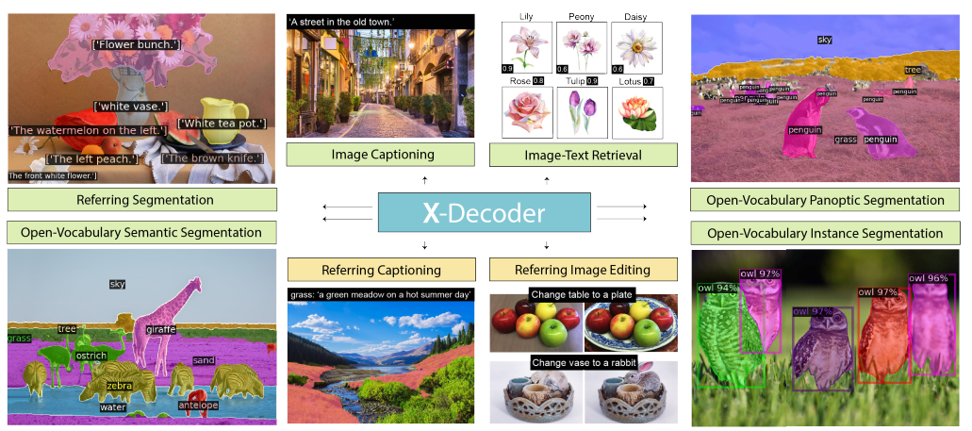
Future work - unified video model
Current video models are still task-specific compared to image models.
[Zou 2023]
[Zhang 2022] GLIPv2: Unifying Localization and Vision-Language Understanding, Haotian Zhang et al, NeurIPS 2022.
[Zou 2023] Generalized Decoding for Pixel, Image, and Language, Xueyan Zhou et al, CVPR 2023.

Slide 47
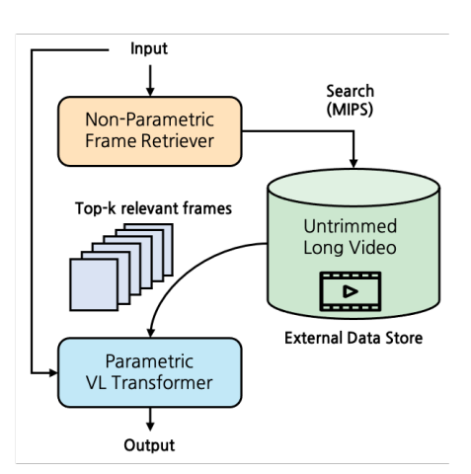
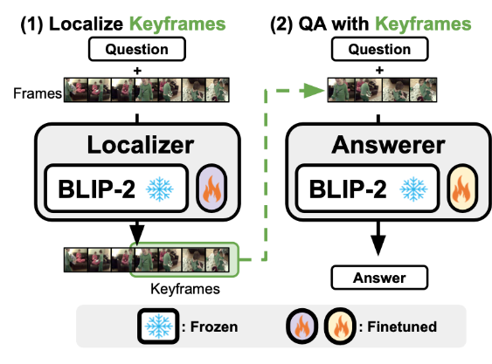
Future work - processing long videos
Can we do better than the standard uniform sampling of frames?
[Kim 2023]
[Yu 2023]
[Kim 2023] Semi-Parametric Video-Grounded Text Generation, Sungdong Kim et al, arXiv 2023.
[Yu 2023] Self-Chained Image-Language Model for Video Localization and Question Answering, Shoubin Yu et al, arXiv 2023.
Notes:
State space models

Slide 48
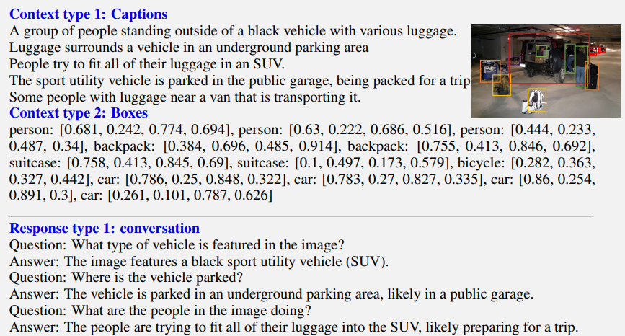
Future work - language models as annotators
Facilitate the collection of video datasets using language models.
[Liu 2023]
[Liu 2023] Visual instruction tuning, Haotian Liu et al, arXiv 2023.
[Zhang 2023] Video-LLaMA: An Instruction-tuned Audio-Visual Language Model for Video Understanding, Hang Zhang et al, arXiv 2023.

Slide 49
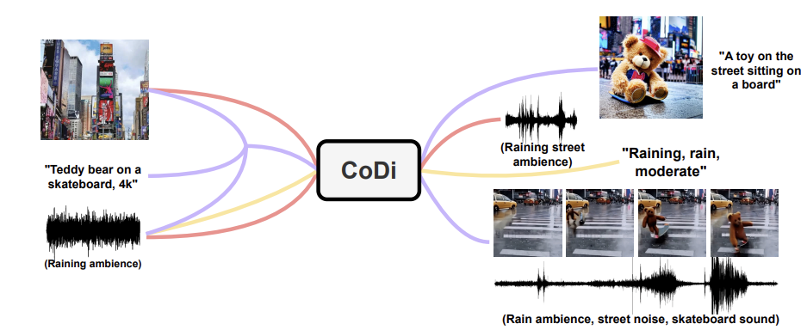
Future work - multi-modality
Build models that can understand more modalities (audio), generate more as well (visual, audio), and learn modalities from one another.
[Tang 2023]
[Girdhar 2023] IMAGEBIND: One Embedding Space To Bind Them All, Rohit Girdhar et al, CVPR 2023.
[Tang 2023] Any-to-Any Generation via Composable Diffusion, Zineng Tang et al, arXiv 2023.

